Slide 1
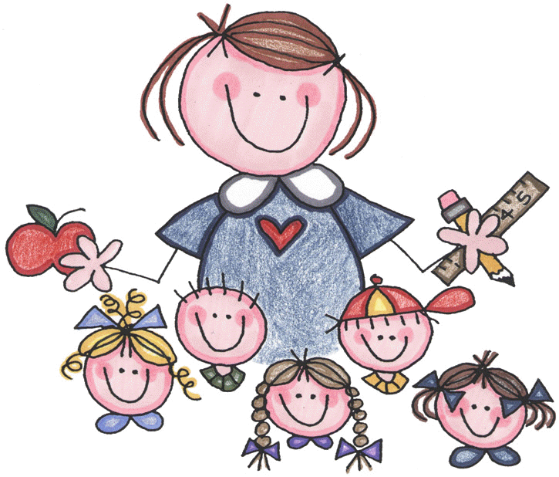
Sheetrim
Primary 1-2 | Primary 3-4 | Primary 5-6 | Primary 7
Bethany Martin Eliza Dickson Nellie Potter | Seth Dickson Maisie Anderson Scott Anderson Rebecca Chambers | Elizabeth Kuck Sam Murphy Lottie Potter Erin-Mae Zwecker Myah Morrison | Tom Murphy Lily Zwecker Charlotte Kuck Samuel Anderson Jim Chambers

Slide 2
Cavanagarvan
Primary 1-2 | Primary 3-4 | Primary 5-6 | Primary 7
Amy Clarke Riley McGurgan Megan McIlveen Zara Maxwell Joshua Mitchell Aliya Rowntree Laura Wilson | Olivia Morton Danny Clarke Archie Dickson Katy Boyd Benjamin Clarke | Harry Dunwoody Becky Robinson | Gray Faloon

Slide 3
Derryhennett
Primary 1-2 | Primary 3-4 | Primary 5-6 | Primary 7
Pippa Murphy Lily Reid James Hall | Lillie Hawthorne Isaac Murphy Sophie Gill Sophia Hall | Samuel Bell Heidi Gill Cameron Glasgow Olivia Robinson Bobby Morton | Aimee Gill Alfie Hawthorne Kyle Murphy Mia Robinson

Slide 4
Longnancys
Primary 1-2 | Primary 3-4 | Primary 5-6 | Primary 7
Eliza Hughes Jacob Marsh William Jenkins Lucy Leeman Alfie Watt | Ella Haffey Isaac Marsh Matthew Straghan Freddie Hughes Luke Nesbitt | James Straghan Drew Leeman Harry Watt | Daniel Haffey Sonny Kerr Ella Straghan Jamie Hutchinson

